Slide 1
EasySell
A fast and light way to manage sales

Slide 2
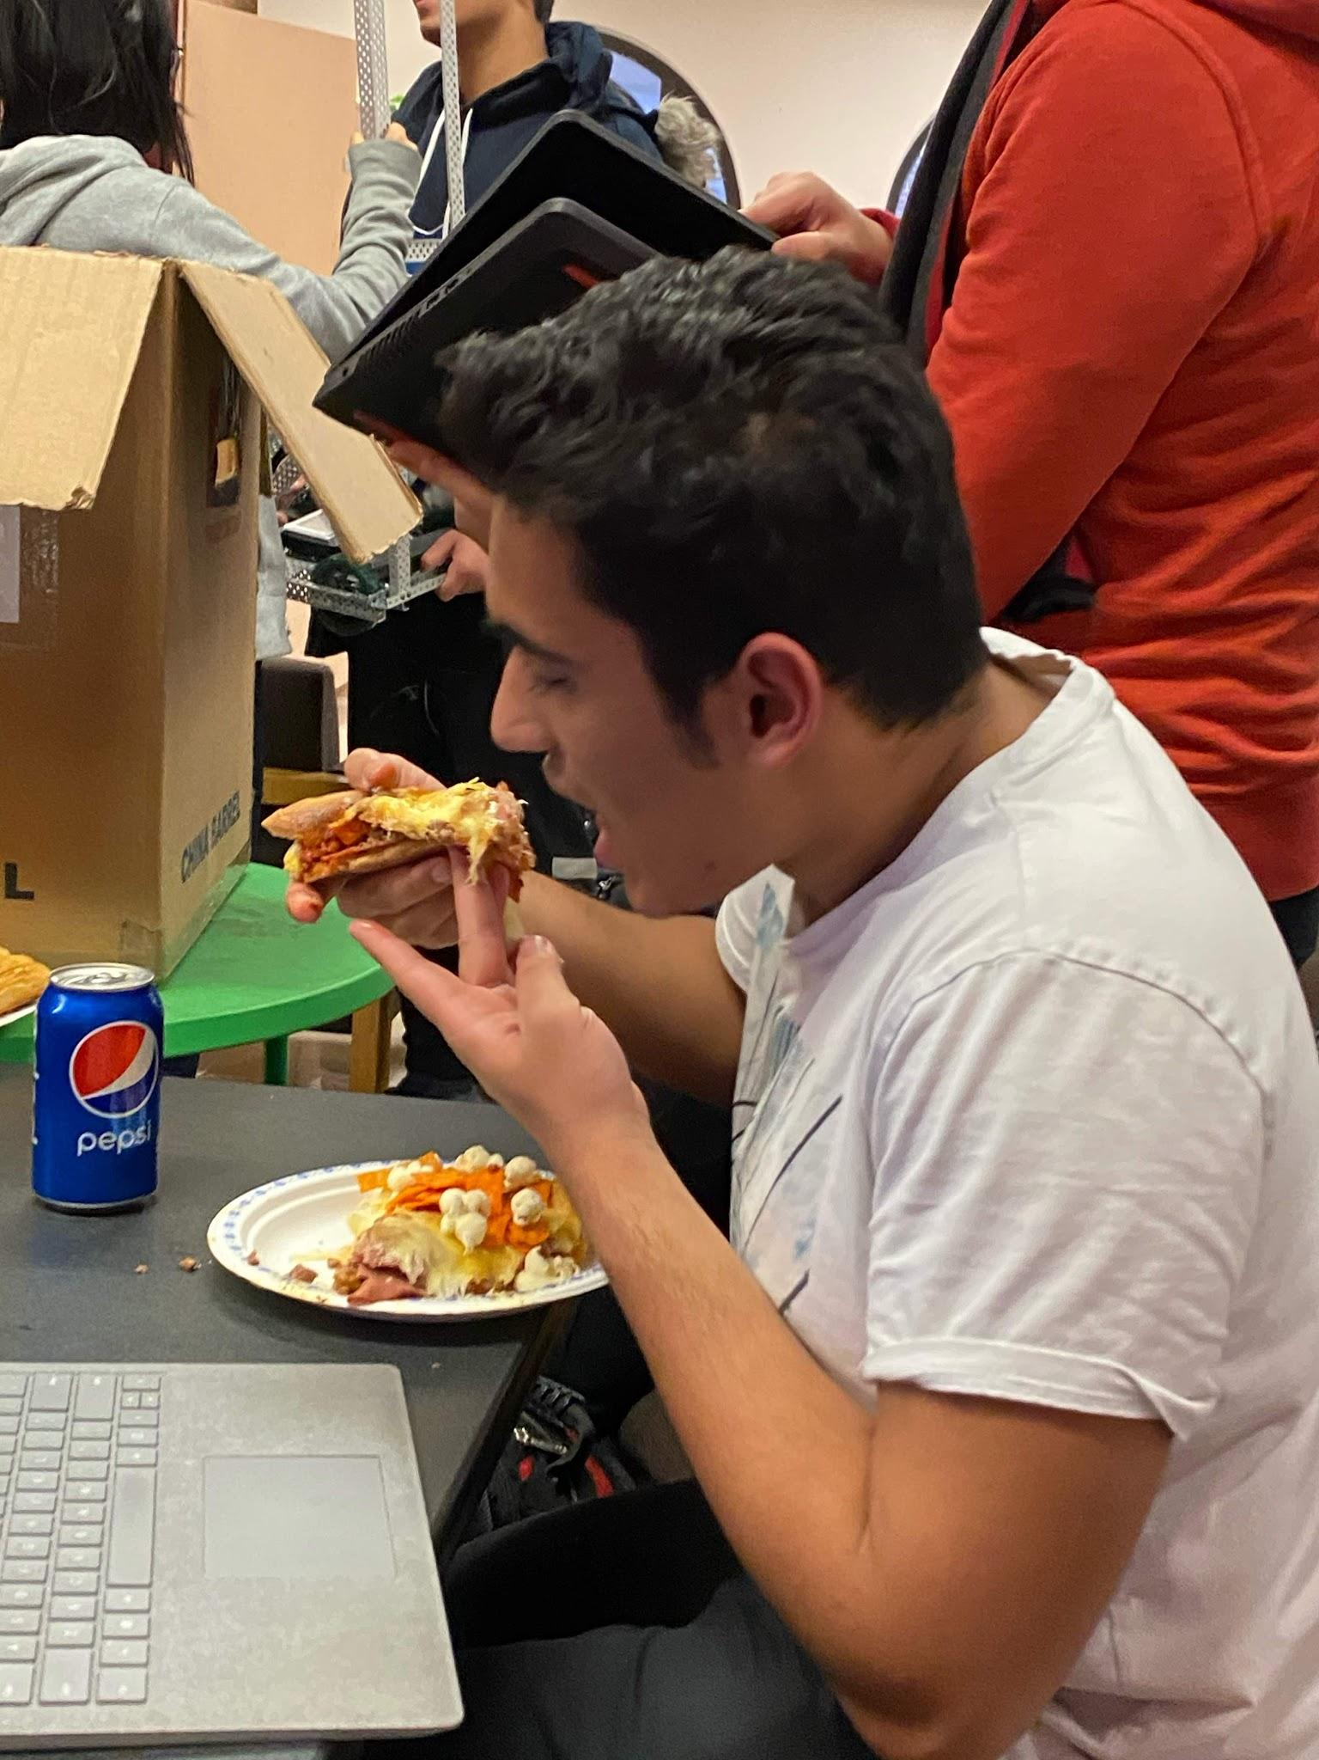
What is EasySell?
Built by Shrinjay Mukherjee
Provides a fast way for users to manage sales and inventory online
Doesn’t take payments
intended for small scale use
Built as a webapp
Allows users to create a profile and login later on
Stores user data

Slide 3
Overview of EasySell

Slide 4
Main Components
Inventory
ability to add/remove items to inventory
able to set amounts, name, price
Transaction Screen
add/remove items to cart
adjust quantities
list of available items on display
Homescreen
overview of inventory and transactions
Login
Registration
create new account
Analytics
shows sales and increase

Slide 5
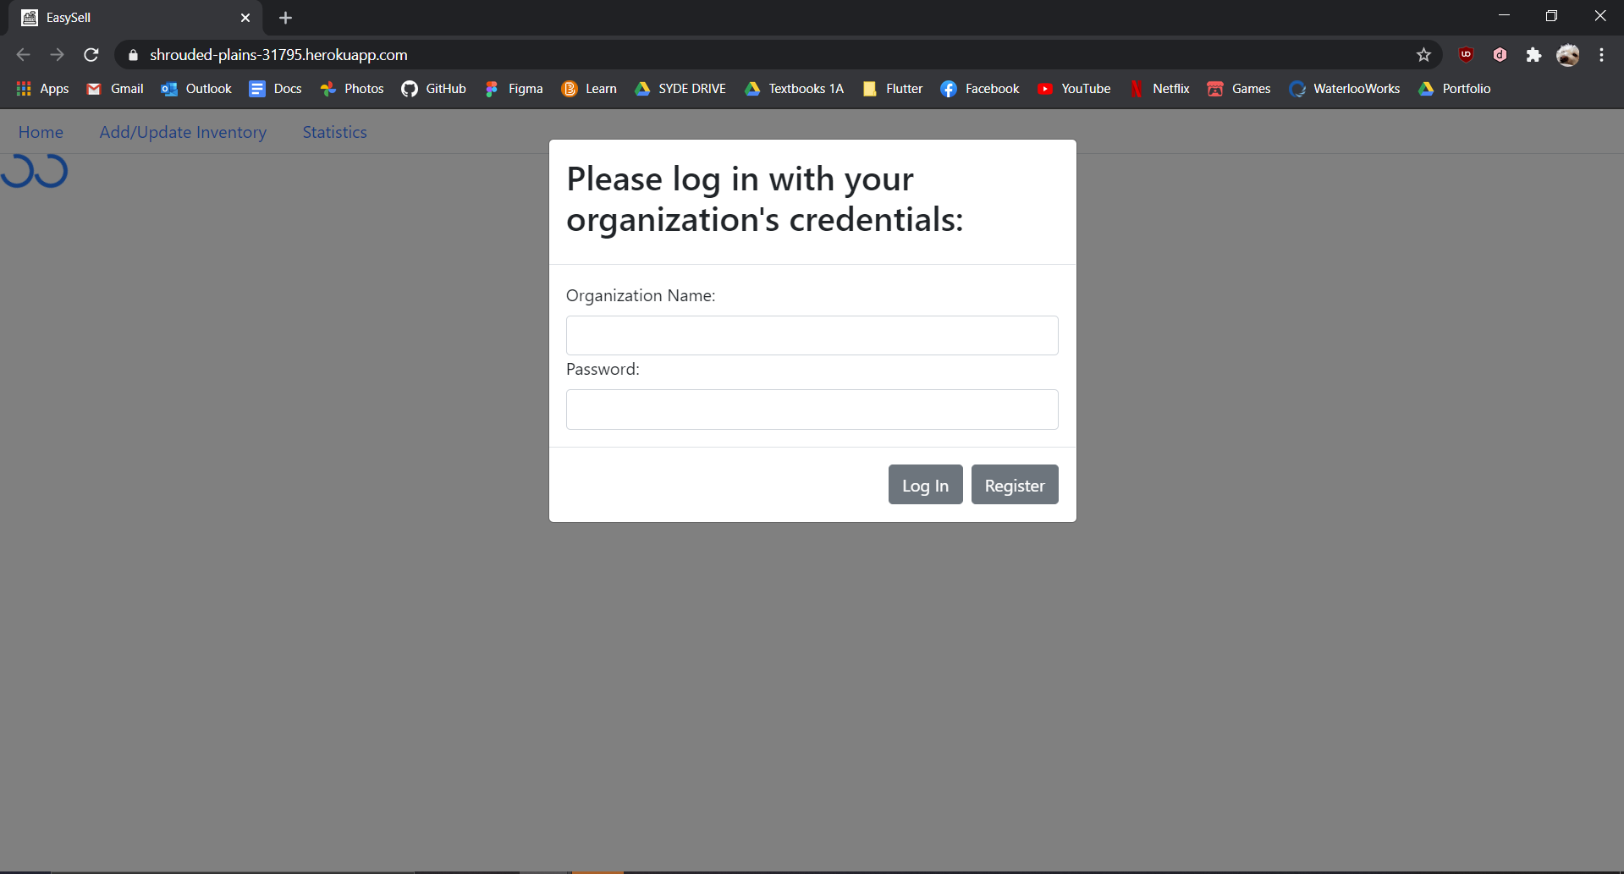
Launch Page
Initial impressions:
very plain
title at the top long and bland
Issues:
very lacklustre
inconsistent w/ registration box
background is unappealing
Icon for tab is very hard to see
Suggested fixes:
possibly have something going on in the background
more padding for the login box
change text weights to match registration box
possible: dedicated login page
more minimalistic logo for icon

Slide 6
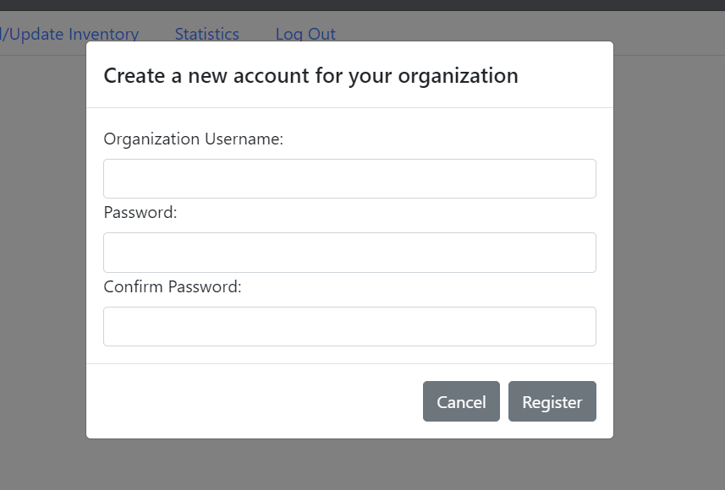
Registration
Initial impressions:
Very straightforward
personally i like the look of this one more than the login
Issues:
similar to login
Passwords don’t need to match in order for me to create an account
I’m able to create multiple organizations with the same name
Suggested fixes:
similar to login
possibly center the header for box
Have little pop-ups that tells user that passwords must match
Tell users right off the bat that passwords must meet certain criteria rather than waiting for them to click the input field to get directions

Slide 7
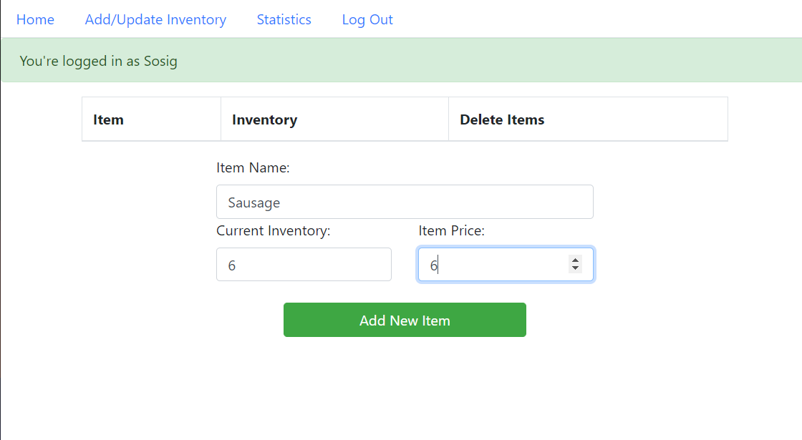
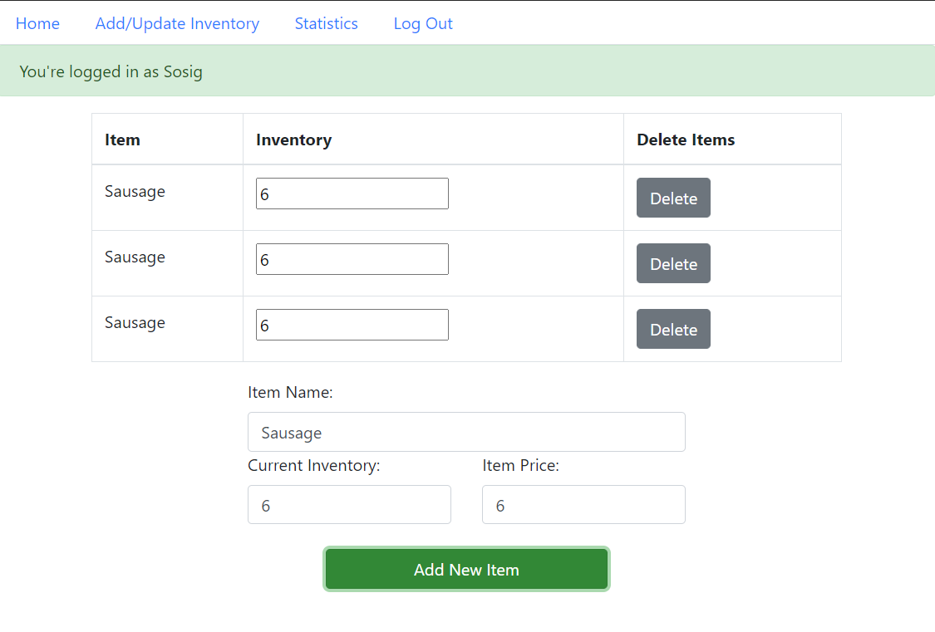
Inventory
Initial impressions:
very boxy
looks like a checklist
minimalistic
Issues:
inconsistent line shading and weights
delete buttons look out of place
logged in is distracting
no way to access profile settings
can't adjust prices
if inventory list gets too long, add function forced to bottom, need to scroll which is inconvenient
no way to sort items
Lines appear in some places but not in others
Able to add multiple items with the same name, and no way to tell them apart

Slide 8
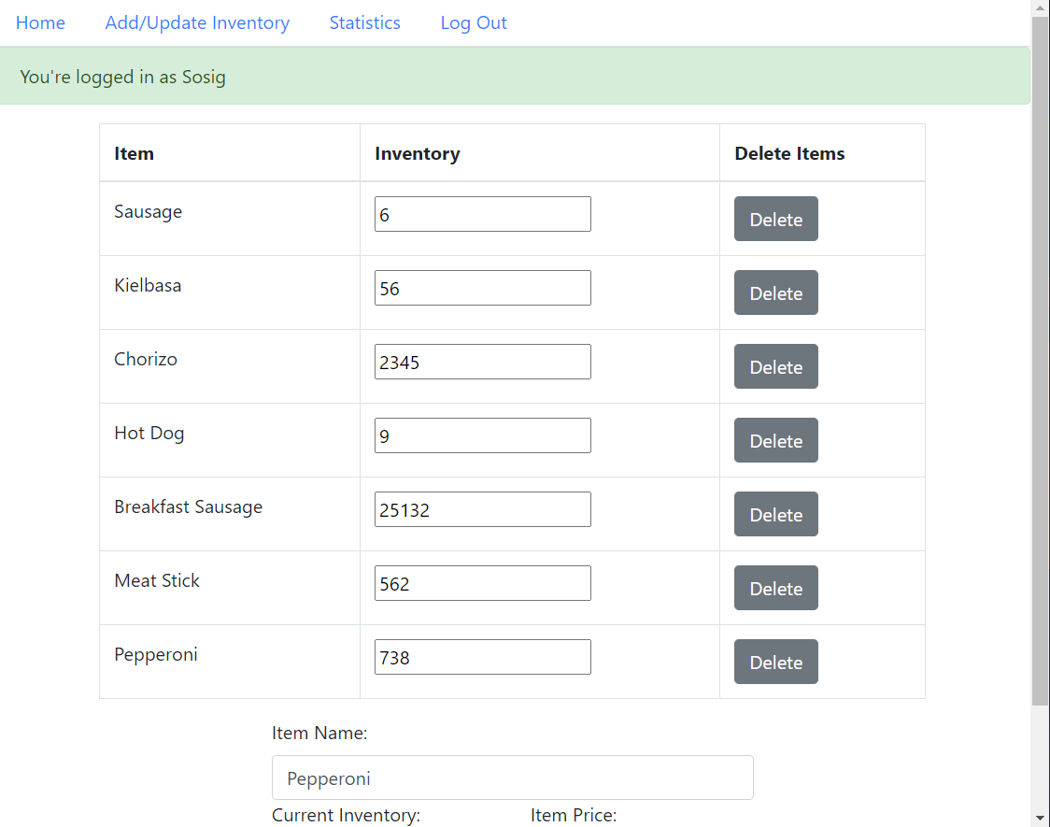
Inventory (cont.)
Suggested fixes:
move add function to the side
Cleaner separation of current inventory and adding new items
possibly center delete button, or remove delete column, it looks out of place
Fix issue where lines don’t appear between each list element or remove lines altogether to make it less boxy
Minor suggestion: change button colour to red, which is typically the colour used for delete buttons
Make it possible to view and edit the price of items

Slide 9
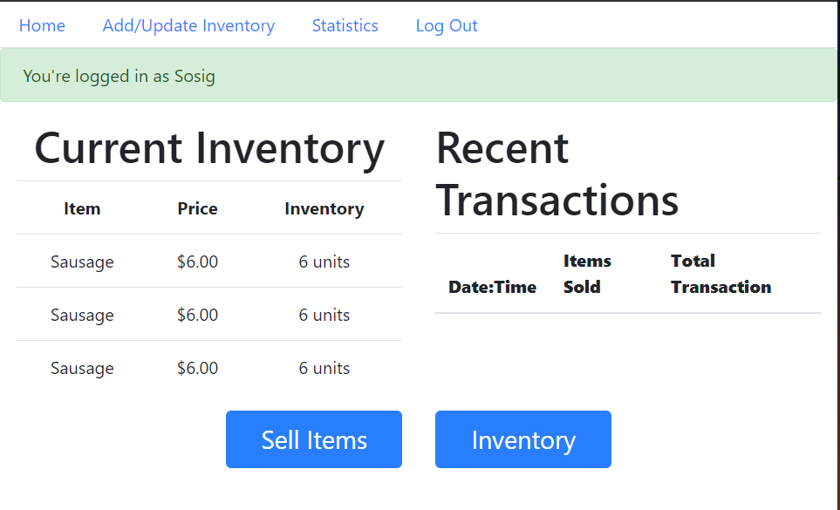
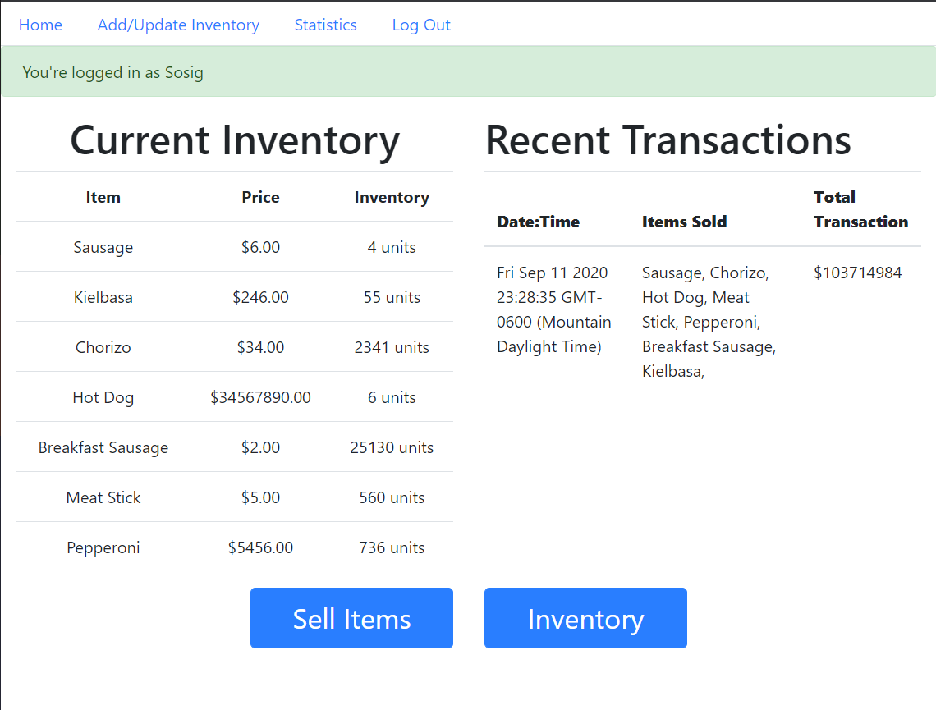
Home
Initial impressions:
Why is the homepage not the first page that appears after registering a user?
Buttons at the bottom are very noticeable
Issues:
The entire page looks cluttered
There is no other way to access the sell items feature other than through the home page
No access to past transactions
If the list of inventory items grows longer, it seems impractical to keep it on the home page, as it would force the sell and inventory buttons to the bottom
Suggested fixes:
Add some space between the current elements on the page to ensure a cleaner separation
Simplify the date/time data, it contributes to the clutter
Make “sell items” part of the nav bar
Possibly take out the buttons at the bottom altogether

Slide 10
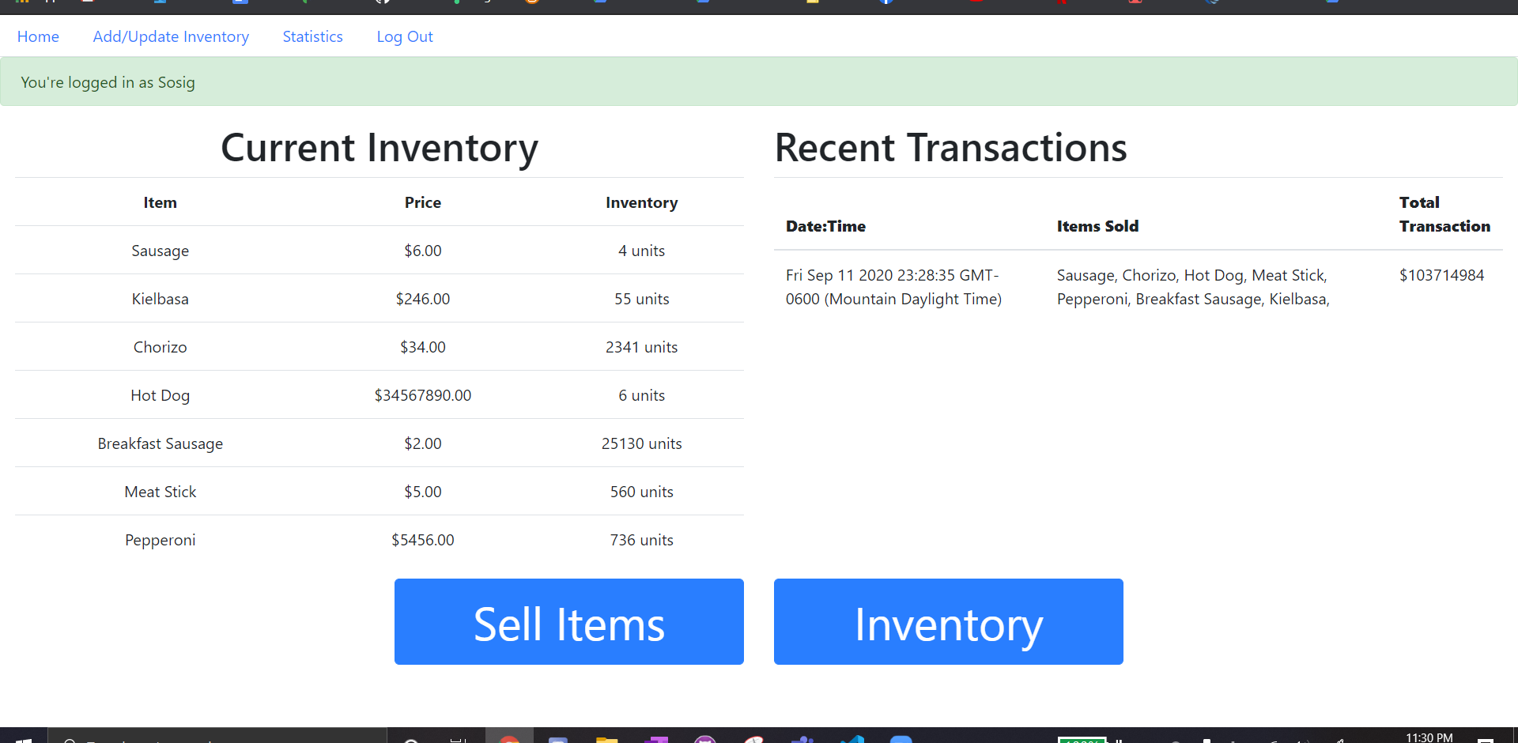

Slide 11
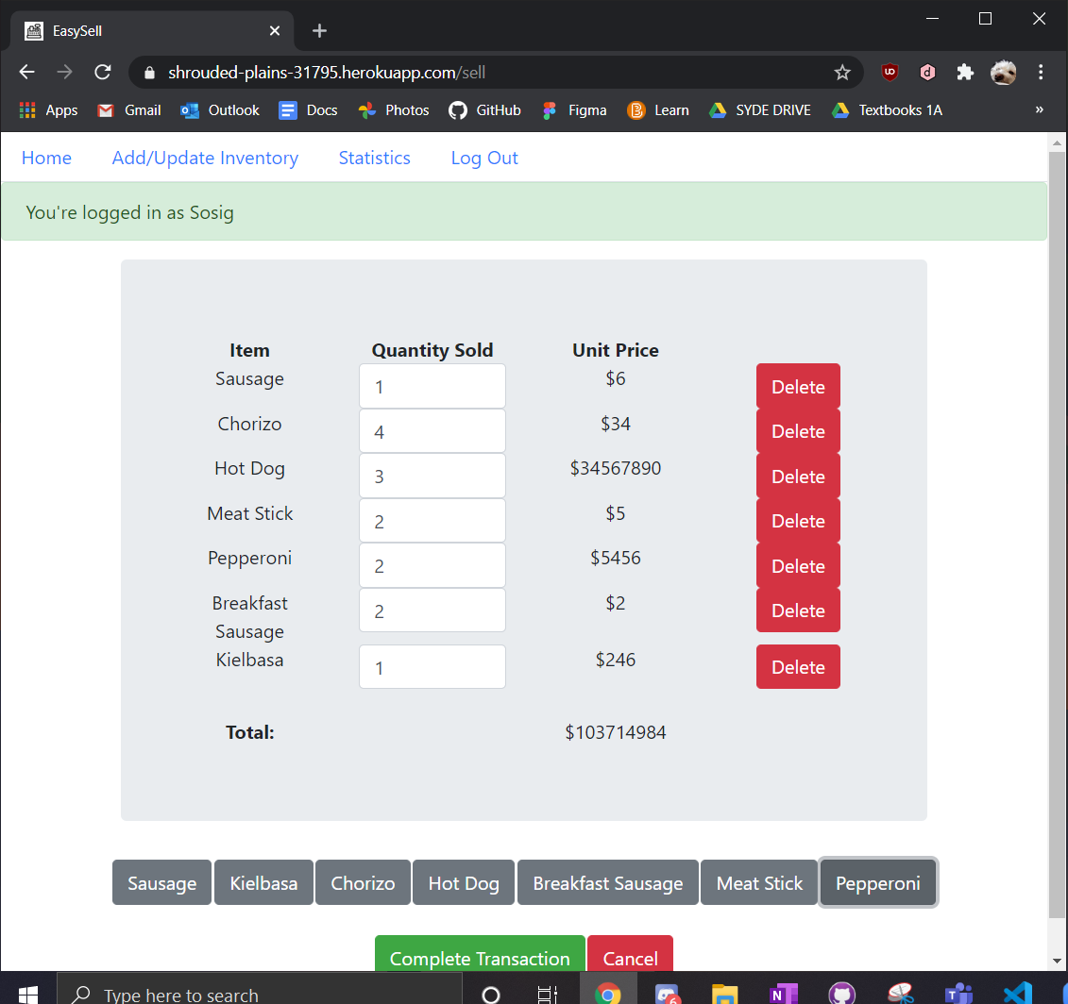
Sell
Initial impressions:
What am I supposed to do with the buttons at the bottom?
The sizing looks awkward
Doesn’t look like anything else on this website
After completing a transaction the page resets without warning
Issues:
When item names get long, it messes up the spacing between list items
The delete buttons are merging together
Design doesn’t work well with large inventories or long transaction lists
When transaction gets long, all buttons are forced to bottom of page
The cancel button looks exactly like the delete buttons

Slide 12
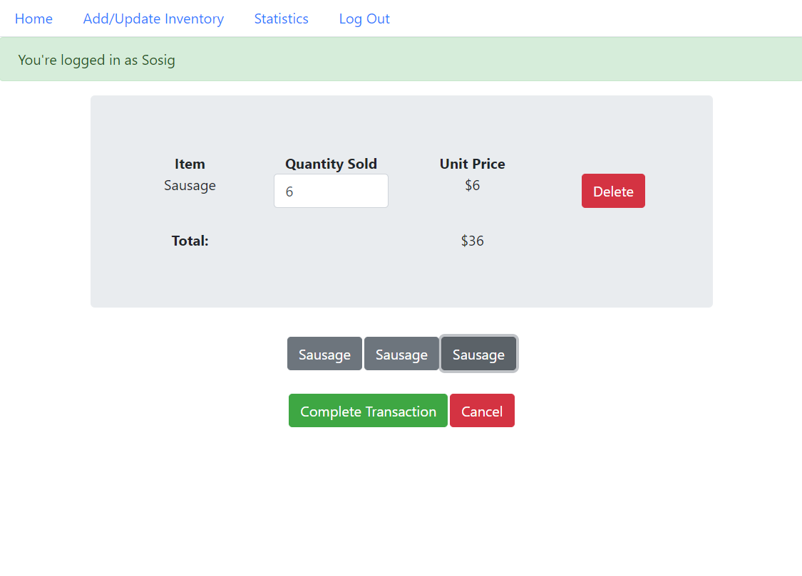
Sell (cont.)
Issues:
Adding items is confusing, there’s no clear indication of where to click
The transaction and cancel buttons aren’t very noticeable
The total merges with the rest of the list
Suggested fixes:
Move the items and transaction buttons to the side, rather than leave them on the bottom
Add spacing to list elements
Have a cleaner separation between the total and the rest of the list

Slide 13
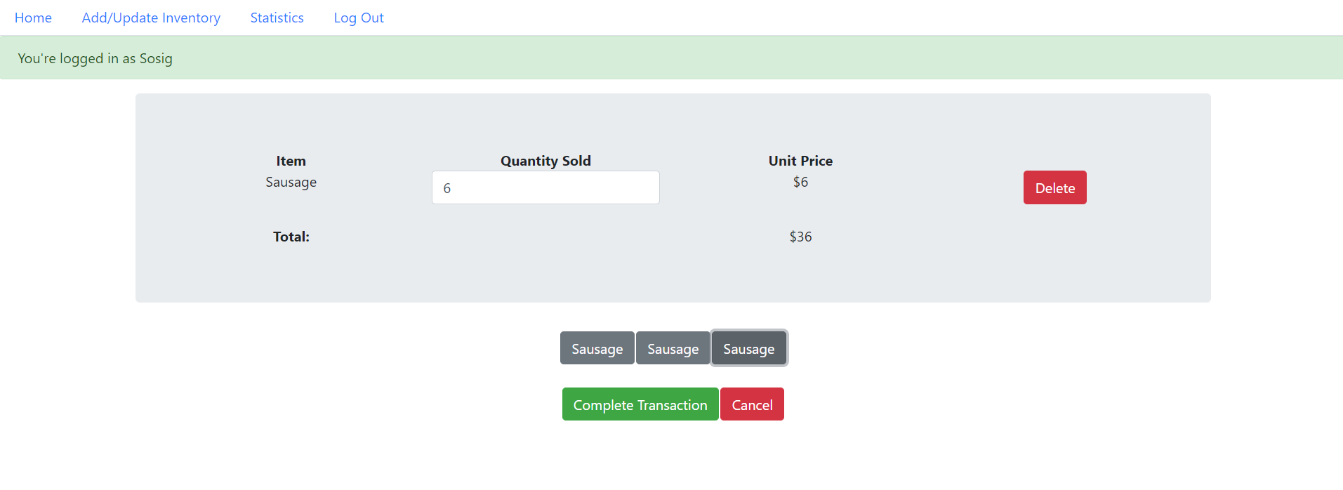
Sell (fullscreen)
Initial impressions:
Issues:
Suggested fixes:

Slide 14
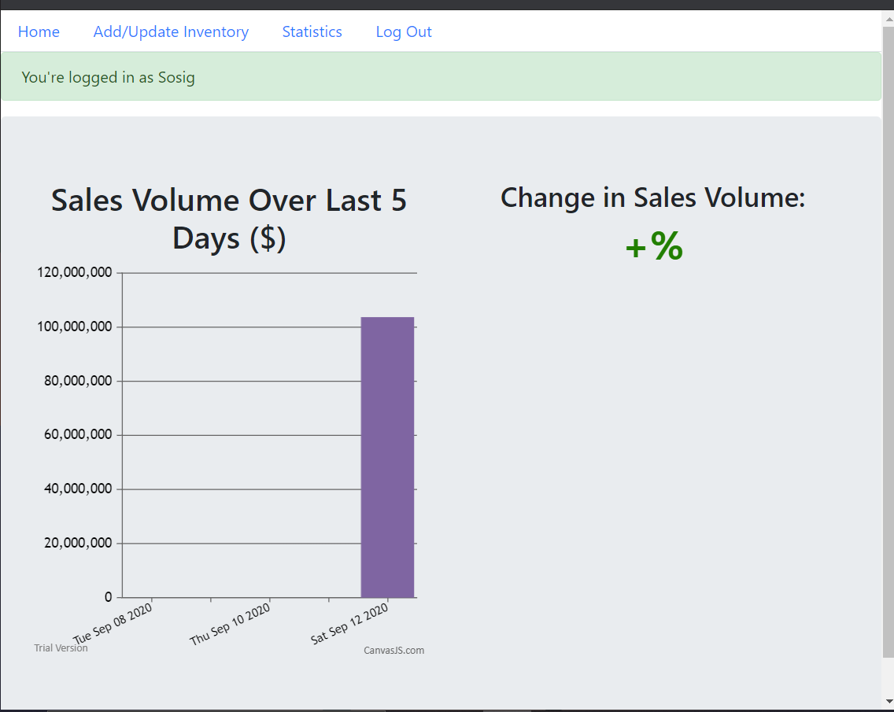
Statistics
Initial impressions:
Not a lot to see here
I expected to see detailed sales information here
Issues:
Feels unnecessary to have a separate page for so little data
Suggested fixes:
Option A: Add more analytics data to this page to flesh it out a bit
Option B: integrate this information into the homepage

Slide 15
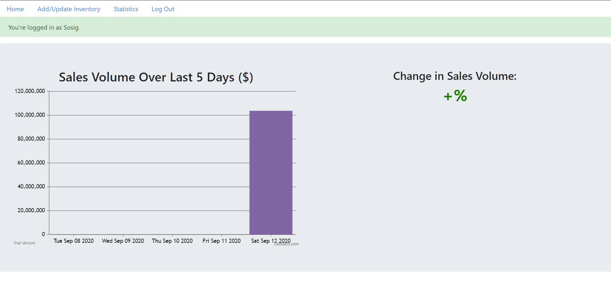
Statistics

Slide 16
Analysis Summary

Slide 17
Overall Impressions
EasySell looks clean, but is also very plain
There is no aesthetically pleasing layout, fun designs, or a colour scheme
Good amount of features and functionality
Analysis feature would be appealing to users concerned with analytics
The flow of the web app is awkward
Navigating to some features is a hassle, and some things are hard to find
Large scale use shows weaknesses in the design
Once lists for transactions and inventories begin getting long, it becomes inconvenient to use
Lack of guidance in usage of the app
Some components such as the add items button is very ambiguous, and it’s not very obvious how to use certain elements or features
The placement, spacing, and sizing of elements feels unnatural
In full screen, some elements would be incredibly spread out, or unnecessarily wide due to the sheer amount of empty space created by the layout of the page
Attention is drawn to the wrong elements on the page

Slide 18
Constraints
Built using ReactStrap
Spin off of Bootstrap framework
Bootstrap has list of utility colours, not very appealing, but saves hassle of having to style through CSS
List of colours: https://getbootstrap.com/docs/4.0/utilities/colors/
Boostrap applications have a tendency to look boxy
Time
Implementing breakpoints for different screen sizes can be time consuming, and may not be useful if Shrinjay intends for EasySell to remain as a web app

Slide 19
Suggestions
Update the nav bar so that all features can be accessed from there, and make the elements easier to read
Change the green logged in bar so that it is temporary
Reformat pages so that they don’t go from top to bottom in order to make it easier to access all elements

Slide 20
Design Mockup
Mockups done in Figma

Slide 21
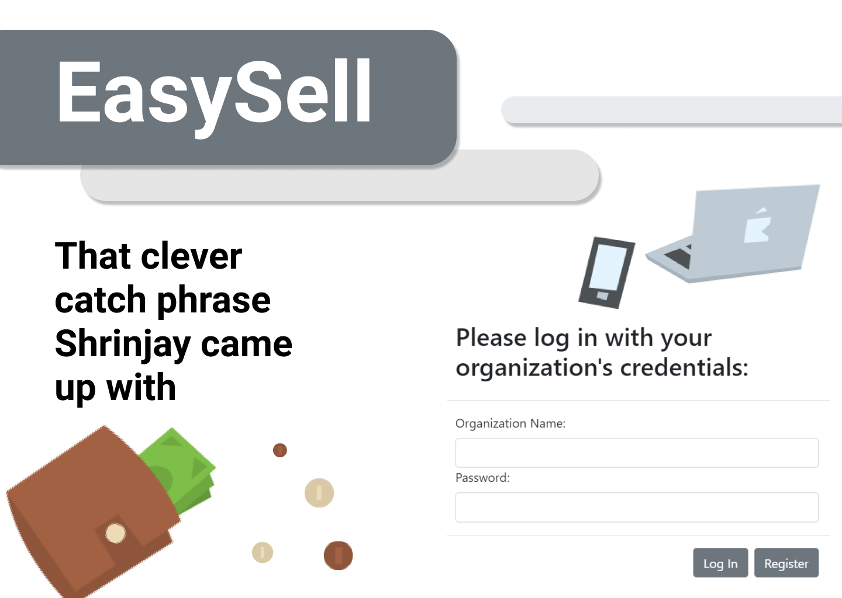

Slide 22
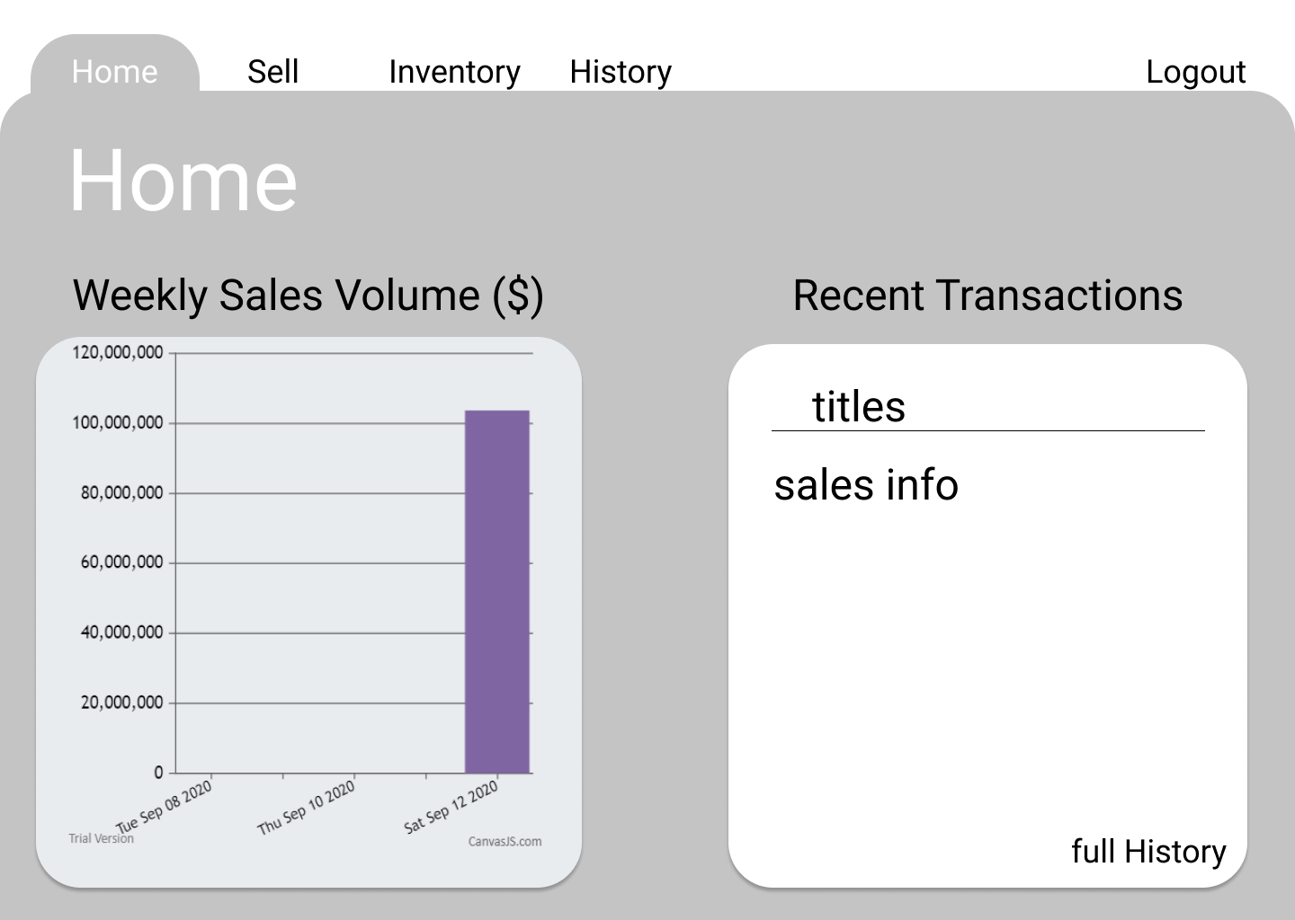

Slide 23
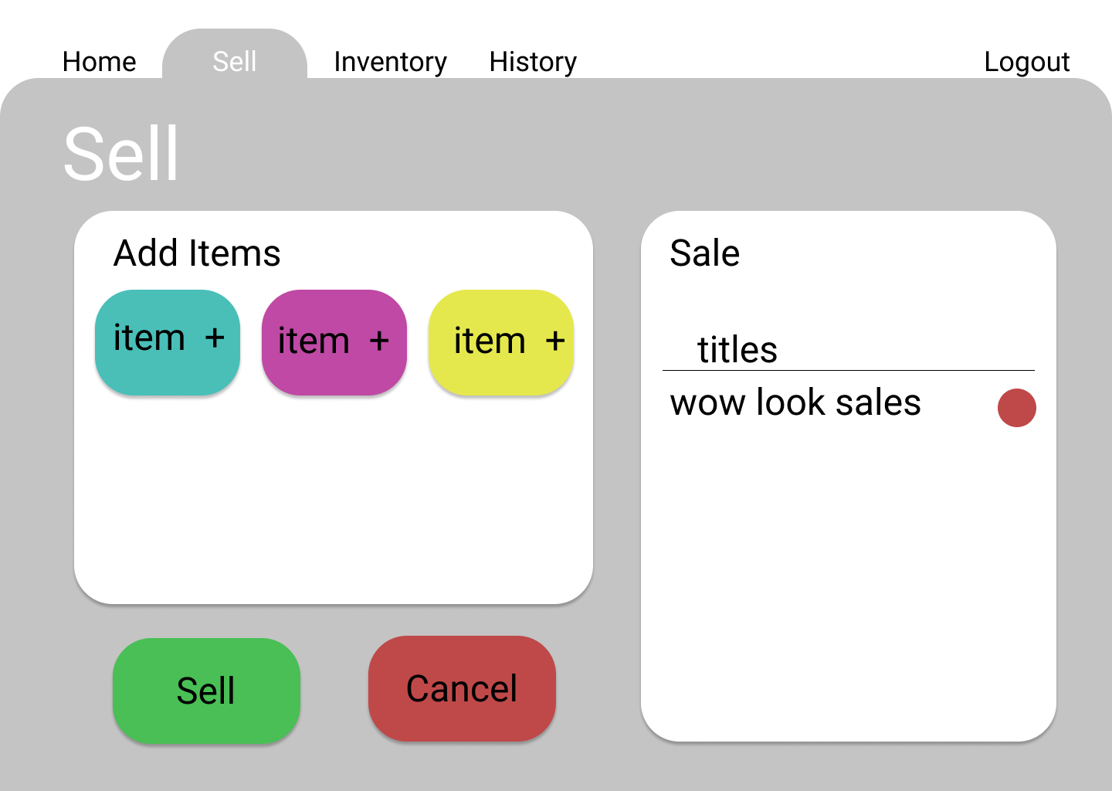

Slide 24
